Slide 1
Data Science Process
Lecture – 4
Sumita Narang

Slide 2
Objectives
Data Science methodology
Business understanding
Data Requirements
Data Acquisition
Data Understanding
Data preparation
Modelling
Model Evaluation
Deployment and feedback
Case Study
Data Science Proposal
Samples
Evaluation
Review Guide

Slide 3
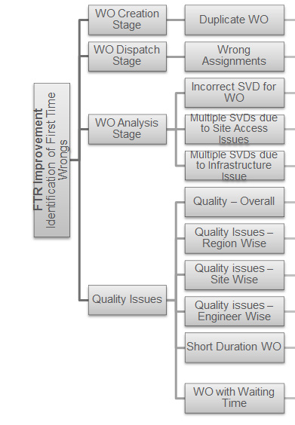
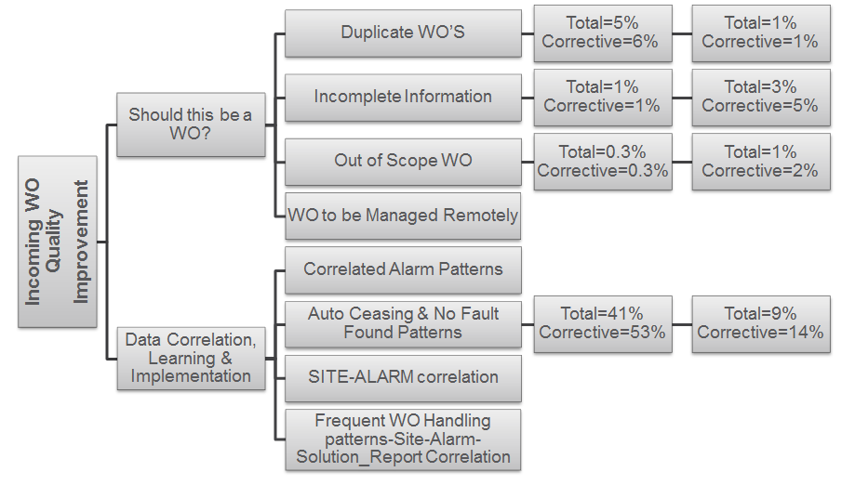
Industry Example – FSO Analytics Tool
Business Objective fro FSO Department: Target for 5 top clients in India, Europe, South Africa and Costa Rica Markets
FTR (Frist Time Right) Improvement by 2%
Improve incoming WO Quality by 5%

Slide 4

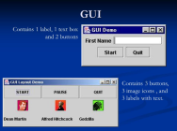

Industry Example - FSO Analytics Tool
Repeated Analysis
Pre & Post Analysis
Aids in doing comparison of same parameters month on month
Easy option to fetch reports
Aids in doing comparison of same parameters across different customer/regions
Ease of performing repeated analysis weekly/monthly, on the same parameters, for same customer
Based on actions identified from analysis, results to be monitored
To support in performing the RCA for problematic areas identified through analysis, tool provides the feature of creating & downloading reports
Highlighting Key Insights based on Analysis
Key highlights & Lowlights from data depicted as textual & tabular insights in the tool
Aids in identifying key improvement areas in order to improve FTR & Incoming WO Quality
WFM Closure Dump
FSO Analytics History DB
Data Aggregation
Analytics GUI Representation
Analysis Procedures Execution

Slide 5
Data Science Process
1. Business Requirement Understanding
2. Data Acquisition & Storage
3. Data Preparation
4. Data Model Creation
5. Evaluate and prove Model
6. Interpret and Present Results
7. Deployment & Operational Support
Notes:
SDLC – Requirement, Design, Implement, Test, Deploy, Support
Business Requirements Understanding
To define a measurable and quantifiable goal
Understand project sponsor needs and limitations
Collaborate with domain expert to understand data sources, data fields, and computational resources
Project sponsor vision to deploy and present the results

Slide 6


Data Science Process
The Team Data Science Process (TDSP) is an agile, iterative
data
science
methodology
to
deliver
predictive
analytics
solutions and intelligent applications efficiently. The process here
that can be implemented with a variety of tools.
Features:
-
Improve Team Collaboration and learning
-
Contains a distillation of the best practices and structures.
-
Helps in successful implementation of data science initiatives
Source Reference
4
BITS Pilani, Pilani Campus

Slide 7
Key components of the TDSP
TDSP comprises of the following key components:
•
A data science lifecycle definition
•
A standardized project structure
•
Infrastructure and resources for data science projects
•
Tools and utilities for project execution
5
BITS Pilani, Pilani Campus

Slide 8
Data Science Lifecycle
The Team Data Science Process (TDSP) provides a lifecycle to structure the
development of your data science projects. The lifecycle outlines the steps,
from start to finish, that projects usually follow when they are executed.
•
Designed for data science projects that ship as part of intelligent applications
•
Machine learning or artificial intelligence models for predictive analytics
•
Exploratory data science projects or ad hoc analytics projects can also
benefit
6
BITS Pilani, Pilani Campus

Slide 9
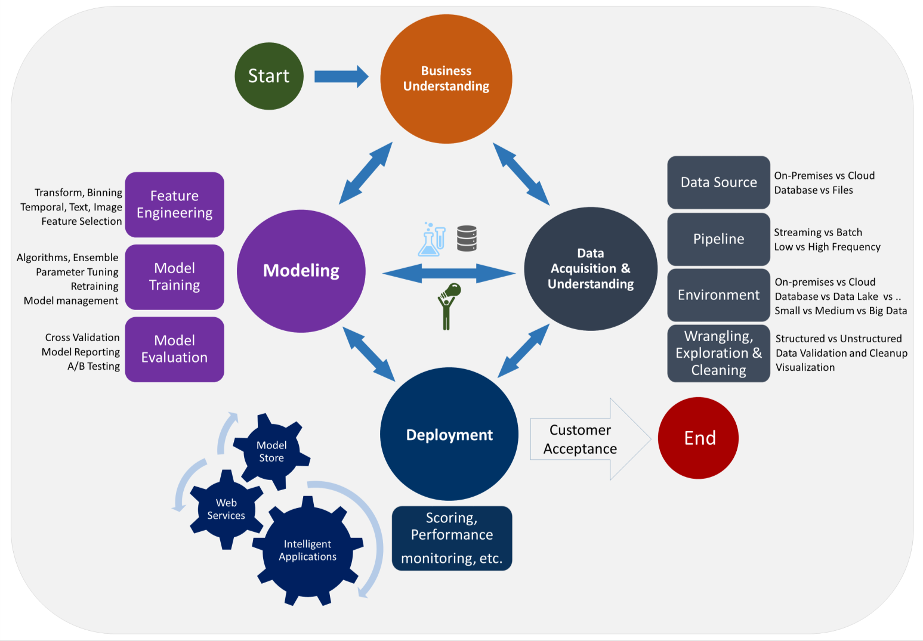
Data Science Lifecycle
7
BITS Pilani, Pilani Campus

Slide 10
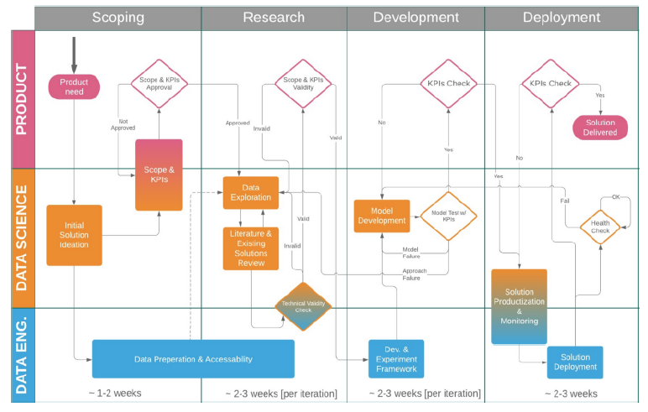
Data Science Project Lifecycle

Slide 11
Detailed stages
Details

Slide 12
Stage 1- Scoping Phase : Business Requirements Understanding
1. Product Need
2. Initial solution ideation – Data Requirements
Understand project sponsor needs and limitations
3. Scope & KPI
Understand Project sponsor vision to deploy and present the results.
Collaborate with SME to understand data sources, data fields, and computational resources
Collaborate with Data Engineer for possible solutions, data sources & data architecture
To define a measurable and quantifiable goal
4. Scope & KPI Approval
Product sponsor approved the KPIs defined
Decide on general algorithmic approach (e.g. unsupervised clustering vs boosted-tree-based classification vs probabilistic inference)
E.g. predicting the expected CTR of an ad with approximation of at least X% in at least Y% of the cases, for any ad that runs for at least a week, and for any client with more than two months of historic data”

Slide 13
Stage 2 -Data Acquisition & Management
Data Acquisition
Stage of collecting or acquiring data from various sources.
Primary Data collection – Data is collected from direct sources. Observation, Interview, Questionnaire, Audit Data, Case Study, Survey Method
Secondary Data collection – Data collected and research analyzed by other agencies, universities
2 Types of Data Collection techniques - Primary Data & Secondary Data Collection.
Develop a solution architecture of the data pipeline that refreshes and scores the data regularly
Ingest the data into the target analytic environment
Set up a data pipeline to score new or regularly refreshed data.
Notes:
CAP theorem – Consistency, Availability and Partition Tolerant – in distributed systems
Partition tolerance in CAP means tolerance to a network partition. An example of a network partition is when two nodes can't talk to each other, but there are clients able to talk to either one or both of those nodes. If you've ever used IRC and experienced a netsplit, this is a great example of that.
Key-Value: Big Hash tables of keys and values. Key is hash function based auto-generated, value can be String, JSON, BLOB
Document based – stores documents with tagged elements; These are also key value based. Key is similar to KV Store; but Value is referred as document. Document is managed data in JSON, BSON (Binary encoded JSON)
Column Based - data is stored in cells grouped in columns of data rather than as rows of data. Columns are logically grouped into column families. Column families can contain a virtually unlimited number of columns that can be created at runtime or the definition of the schema. Read and write is done using columns rather than rows.
Graph DBs – RDF based knowledge graphs

Slide 14
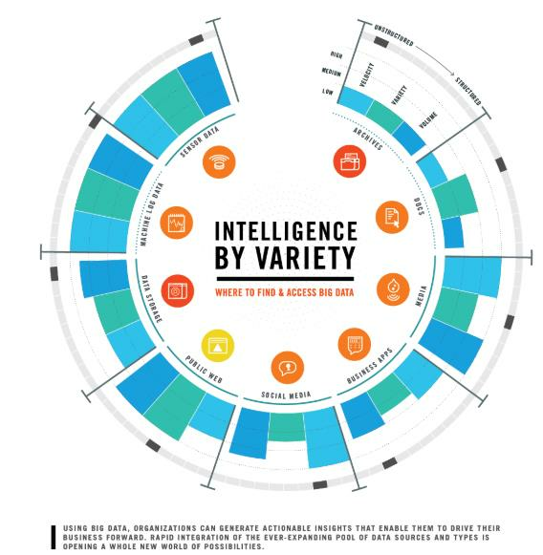
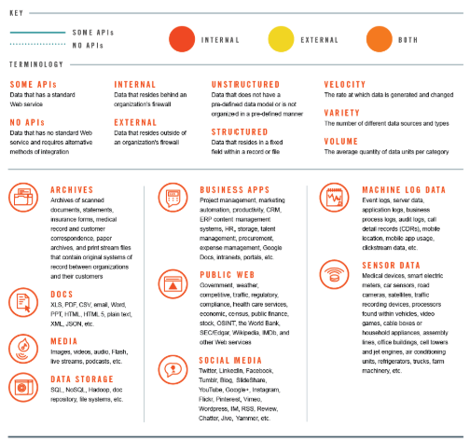
Data Acquisition from
Sources & Variety of data
https://datafloq.com/read/understanding-
sources-big-data-infographic/338
21
BITS Pilani, Pilani Campus

Slide 15
Data Management / Warehousing
Data Management/ Warehousing
Administrative process that includes acquiring, validating, storing, protecting, and processing required data to ensure the accessibility, reliability, and timeliness of the data for its users.
Relational Databases – RDBMS: Structured information & adherence to strong schema, ACID (Atomicity, Consistency, Isolation and Durability) properties, SQL based real time querying
NoSQL Databases – 4 types: 1. Key-Value (Amazon S3, Riak) 2. Document based store ( CouchDB, MongoDB ) 3. Column-Based Store (Hbase, Cassandra ) 4. Graph-Based ( Neo4J)

Slide 16
Stage 3: Data Preparation 1/
Data Preparation is the process of collecting, cleaning, and consolidating data into one file or data table, primarily for use in analysis.
Handling messy, inconsistent, or un-standardized data
Trying to combine data from multiple sources
Handling of missing values, boundary values, deleting duplicate values
Validation of data, reliability and correctness checks
Dealing with data that was scraped from an unstructured source such as PDF documents, images etc.
Feature engineering, feature reduction/scaling
Explore dimensions; find deficiencies in data
Add more data sources if required with support from Data Engineer
Data Understanding & Exploration/ Data Preparation
Produce a clean, high-quality data set whose relationship to the target variables is understood. Locate the data set in the appropriate analytics environment so you are ready to model.

Slide 17
Stage 3: Data Preparation 2/
The key steps to your data preparation:
Data analysis – The data is audited for errors ;anomalies to be corrected. For large datasets, data preparation prove helpful in producing metadata & uncovering problems.
Creating an intuitive workflow – A workflow consisting of a sequence of data prep operations for addressing the data errors is then formulated.
Validation – The correctness of the workflow is next evaluated against a representative sample of the dataset; Leading to adjustments to the workflow as previously undetected errors are found.
Transformation – Once convinced of the effectiveness of the workflow, transformation may now be carried out, and the actual data prep process takes place.
Backflow of cleaned data – Finally, steps must also be taken for the clean data to replace the original dirty data sources.

Slide 19
Stage 3- Data Pre-processing contd..
Algorithms require features with some specific characteristic to work properly. Here,
the need for feature engineering arises
•
Preparing the proper input dataset, compatible with the machine learning
algorithm requirements.
•
Improving the performance of machine learning models.
data scientists spend 80% of their time on data
preparation:
25
BITS Pilani, Pilani Campus

Slide 20
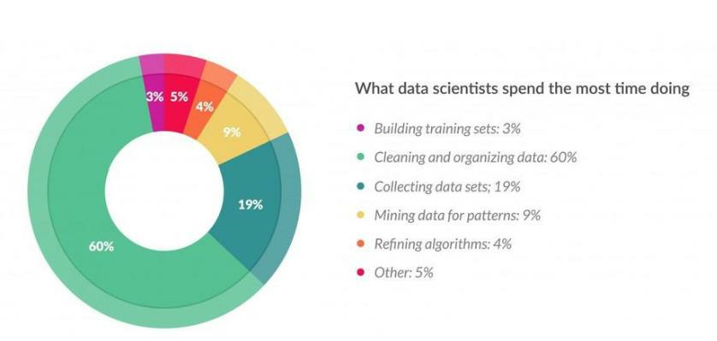
Stage 3:Data Pre-processing contd..
Data scientists spend 80% of their time on data preparation:
Source: https://www.forbes.com/sites/gilpress/2016/03/23/data-preparation-most-time-consuming-least-
enjoyable-data-science-task-survey-says/
26
BITS Pilani, Pilani Campus

Slide 21
Stage 3: Data Pre-processing steps
Data Cleaning: Data is cleansed through processes such as filling in missing
values, smoothing the noisy data, or resolving the inconsistencies in the data.
Techniques like- dropping missing values beyond a threshold, filling with mean/
Median; Imputation; Binning etc.
Data Integration: Data with different representations are put together and
conflicts within the data are resolved.
Data Transformation: Data is normalized, aggregated and generalized.
Data Reduction: This step aims to present a reduced representation of the data
in a data warehouse.
Data Discretization: Involves the reduction of a number of values of a
continuous attribute by dividing the range of attribute intervals.
27
BITS Pilani, Pilani Campus

Slide 22
Stage 3:Data Pre-processing
Techniques – Data Transformations
•
Imputation
•
Handling Outliers
•
Binning
•
Log Transform
•
One-Hot Encoding
•
Grouping Operations
•
Feature Split
•
Scaling
•
Extracting Date
https://towardsdatascience.com/feature-engineering-for-machine-learning-3a5e293a5114
28
BITS Pilani, Pilani Campus

Slide 23
Preparing The Data
Dealing with missing data
It is quite common in real-world problems to miss some values of our data
samples. It may be due to errors on the data collection, blank spaces on
surveys, measurements not applicable…etc
Missing values are tipically represented with the “NaN” or “Null” indicators. The
problem is that most algorithms can’t handle those missing values so we need
to take care of them before feeding data to our models. Once they are
identified, there are several ways to deal with them:
•
Eliminating the samples or features with missing values. (we risk to delete
relevant information or too many samples)
•
Imputing the missing values, with some pre-built estimators such as the
Imputer class from scikit learn. We’ll fit our data and then transform it to
estimate them. One common approach is to set the missing values as the
mean value of the rest of the samples.
12
BITS Pilani, Pilani Campus

Slide 24
Feature Scaling
This is a crucial step in the preprocessing phase as the majority of machine
learning algorithms perform much better when dealing with features that are on the same scale. In most cases, the numerical features of the dataset do not have a certain range and they differ from each other. In real life, it is nonsense to expect age and income columns to have the same range. But from the machine learning point of view, how these two columns can be compared? Scaling solves this problem. The continuous features become identical in terms of the range, after a scaling process. This process is not mandatory for many algorithms, but it might be still nice to apply. However, the algorithms based on distance calculations such as k-NN or k-Means need to have scaled continuous features as model input. The most common techniques are:
•
Normalization: it refers to rescaling the features to a range of [0,1], which is
a special case of min-max scaling. To normalize our data we’ll simply need
to apply the min-max scaling method to each feature column.
•
Standardization: it consists in centering the feature columns at mean 0 with
standard deviation 1 so that the feature columns have the same parameters
as a standard normal distribution (zero mean and unit variance).
14
BITS Pilani, Pilani Campus

Slide 25
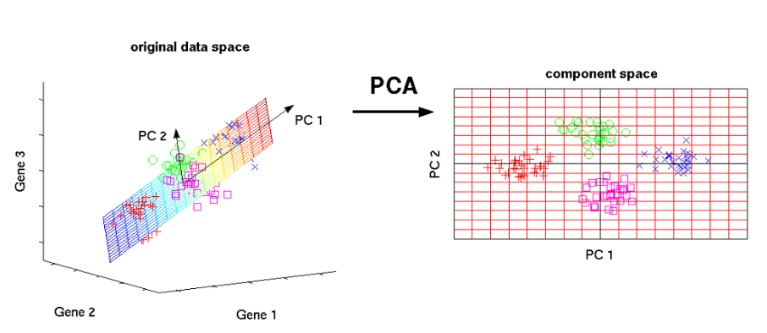
Preparing The Data -Selecting Meaningful Features
One of the most common solution to avoid overfitting is to reduce data’s
dimensionality. This is frequently done by reducing the number of features of
our dataset via Principal Component Analysis (PCA).
15
BITS Pilani, Pilani Campus

Slide 26
Central Limit Theorem
The Central Limit Theorem (CLT) is a statistical theory states that given a sufficiently large sample size from a population with a finite level of variance, the mean of all samples from the same population will be approximately equal to the mean of the population.
Larger the sample size, the more would be the normal distribution of means of samples

Slide 27
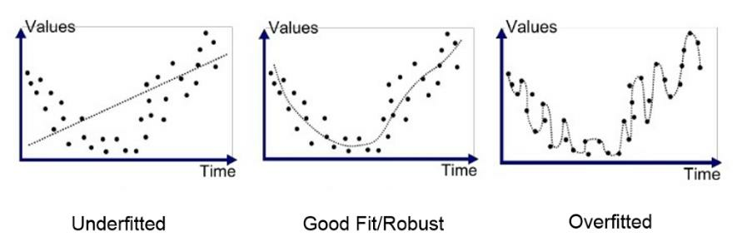
Preparing The Data-Splitting
Data Into Subsets
In general, we will split our data in three parts: training, testing and validating
sets. We train our model with training data, evaluate it on validation data and
finally, once it is ready to use, test it one last time on test data.
The ultimate goal is that the model can generalize well on unseen data, in other
words, predict accurate results from new data, based on its internal parameters
adjusted while it was trained and validated.
a) Learning Process
b) Over-fitting & Under-fitting
16
BITS Pilani, Pilani Campus

Slide 28
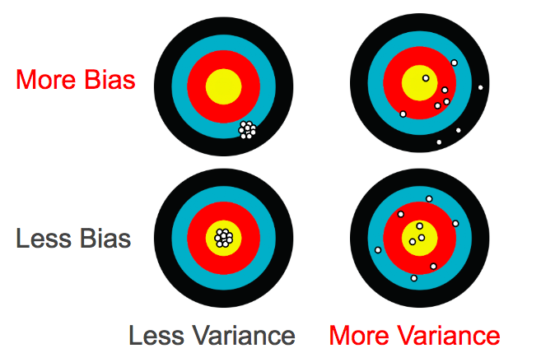
What is Bias & Variance in data
https://towardsdatascience.com/what-is-ai-bias-6606a3bcb814

Slide 29
Tools for Data Preparation
R – Data-tables and related libraries
http://www.milanor.net/blog/preparing-the-data-for-modelling-with-r/
https://www.udacity.com/course/data-analysis-with-r--ud651
https://www.datacamp.com/home (Course: Introduction to R )
https://courses.edx.org/courses/course-v1:Microsoft+DAT209x+5T2016/course/
Python – Pandas libraries, Numpy, scipy, EDA libraries
https://www.kdnuggets.com/2017/06/7-steps-mastering-data-preparation-python.html
https://www.analyticsvidhya.com/blog/2016/01/top-certification-courses-sas-r-python-machine-learning-big-data-spark-2015-16/#five
Self Service Data Preparation tools - Examples: Clearstory data, Datameer, Microsoft Power query for Excel, Pixata, Tamr, Big Data analyzeretc.
(https://www.predictiveanalyticstoday.com/data-preparation-tools-and-platforms/)

Slide 30
Extra Reading
How to depict Dependent and independent variables in data? How to depict data correlation?
http://www.sthda.com/english/wiki/visualize-correlation-matrix-using-correlogram
https://datavizcatalogue.com/search/relationships.html
https://www.khanacademy.org/math/pre-algebra/pre-algebra-equations-expressions/pre-algebra-dependent-independent/v/dependent-and-independent-variables-exercise-example-2
How to compensate for missing values ?
https://towardsdatascience.com/6-different-ways-to-compensate-for-missing-values-data-imputation-with-examples-6022d9ca0779
https://measuringu.com/handle-missing-data/

Slide 31
References
https://www.bouvet.no/bouvet-deler/roles-in-a-data-science-project
https://www.altexsoft.com/blog/datascience/how-to-structure-data-science-team-key-models-and-roles/
https://www.quora.com/What-is-the-life-cycle-of-a-data-science-project
https://towardsdatascience.com/5-steps-of-a-data-science-project-lifecycle-26c50372b492
https://www.dezyre.com/article/life-cycle-of-a-data-science-project/270
https://www.slideshare.net/priyansakthi/methods-of-data-collection-16037781
https://www.questionpro.com/blog/qualitative-data/
https://surfstat.anu.edu.au/surfstat-home/1-1-1.html
https://www.mymarketresearchmethods.com/types-of-data-nominal-ordinal-interval-ratio/
https://www.coursera.org/learn/decision-making

